Slide 1
Decision Trees
Week 1
Sohini Roychowdhury

Slide 2
Outline
Tree based methods
Regression Trees

Slide 3
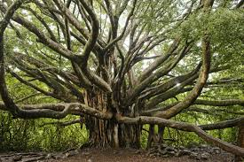
Tree-based methods

Slide 4
Basic Idea
Given Data X={x_{1,} x_{2,…} x_{n}}, Y

Slide 5
x₂
Region2 (R2)
Region1 (R1)
x₂ª
Region3 (R3)
x₁ª
x₁

Slide 6
x₁
X₁<x₁ª
x₁>x₁ª
x₂
R1
X₂<x₂ª
x₂>x₂ª
R3
R2
Segment the data space (X) into sub-regions.
Predicted variable: mean, median, mode of segment

Slide 7
Why Trees? An Example..
What would you do tonight? Decide amongst the following:
Finish homework
Go to a party
Read a book
Hang out with friends
Notes:
We split the predictor space as brunches of a tree and therefore these methods are called decision tree methods

Slide 8
Homework Deadline tonight?
Yes
No
Do homework
Party invitation?
Yes
No
Do I have friends
Go to the party
Yes
No
Read a book
Hang out with friends

Slide 9

Random Decision Forest
Multiple trees can yield generalizable results for previously unseen data samples.

Slide 10
Outline
Tree based methods
Regression Trees

Slide 11
Regression
Build a regression tree:
Divide the predictor space into J distinct not overlapping regions R₁,R₂,R₃,…,R_{J}
Make the same prediction (mean/median/mode) for all observations in the same region;

Slide 12
x₂
Region2 (R2)
Region1 (R1)
y=2.2
y=3.2
Region3 (R3)
y=5.6
x₁

Slide 13
Finding the sub-regions
The regions could have any shape.
But we choose just rectangles
x₂
Region2
x₂
Region2
Region1
Region1
Y=2.5
y=2.2
Y=2.9
Y=3.2
Region3
Region3
Y=5.1
y=5.6
x₁
x₁

Slide 14
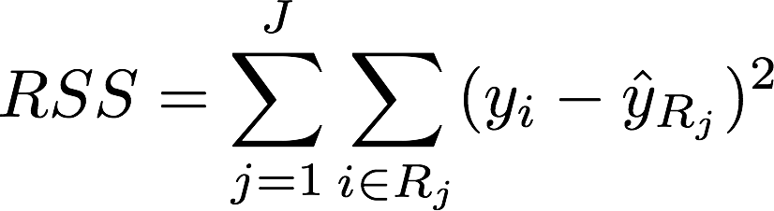

Find boxes R₁, . . . , R_{J} that minimize the Residual sum of squares (RSS)
where is the mean response value of all training observations in the R_{j} region
This computationally very expensive!
Solution: Top down approach, greedy approach
recursive binary splitting

Slide 15
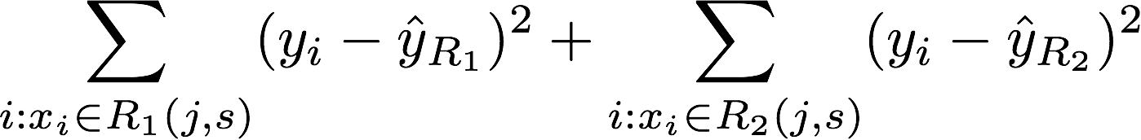
Recursive Binary Splitting
Consider all predictor X_{p} and all the all possible values of the cutpoints ‘s’ for each of the predictors. Choose the predictor and cutpoint s.t. it minimizes the RSS
This can be done quickly, assuming number of predictors is not very large
Repeat #1 but only consider the sub-regions
Stop when: node contains only one class or node contains less than n data points or max depth is reached

Slide 16
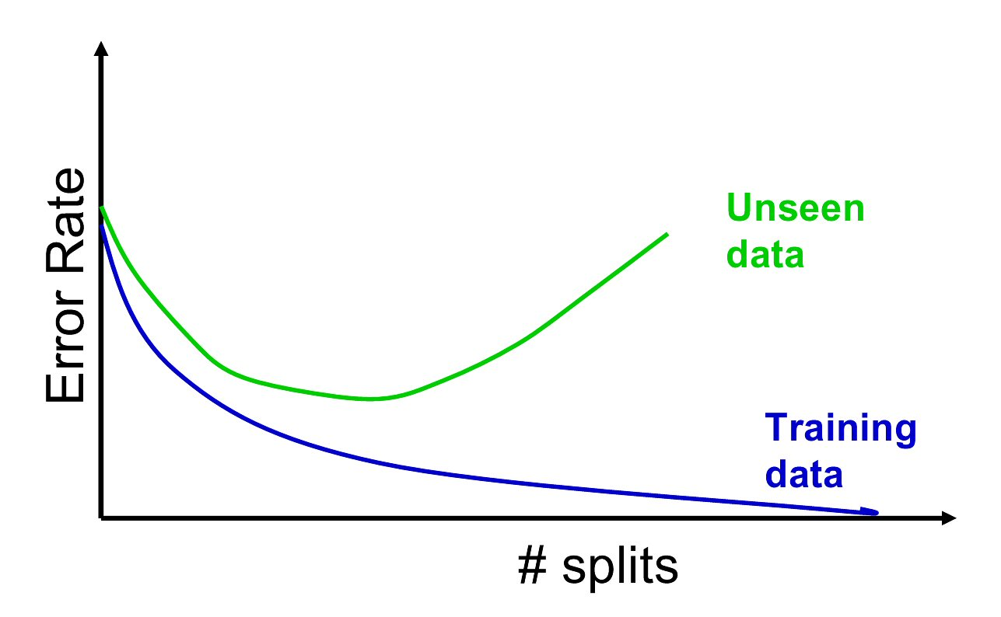
Overfitting
If we keep splitting we will be reducing RSS
Overfitting leads to low predictive accuracy of new data
Past a certain point, the error rate for the validation data starts to increase

Slide 17
Pruning
Random Decision Trees lets tree grow to full extent, then prunes it back
Idea is to find that point at which the validation error begins to rise
Generate successively smaller trees by pruning leaves
At each pruning stage, multiple trees are possible
Use cost complexity to choose the best tree at that stage

Slide 18
Cost Complexity
CC(T) = Err(T) + α L(T)
CC(T) = cost complexity of a tree
Err(T) = proportion of misclassified records
= penalty factor attached to tree size (set by user) [regularizer]
L(T)= number of terminal nodes
Among trees of given size, choose the one with lowest CC
Do this for each size of tree
Notes:
Alpha=0 full tree, alpha=inf, one node leaf only

Slide 19
Using Validation Error to Prune
Pruning process yields a set of trees of different sizes and associated error rates
Two trees of interest:
Minimum error tree
Has lowest error rate on validation data
Best pruned tree
Smallest tree within one std. error of min. error
This adds a bonus for simplicity/generalizability

Slide 20
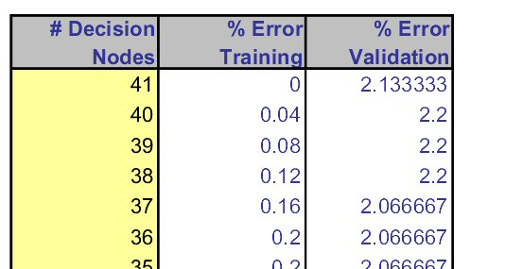
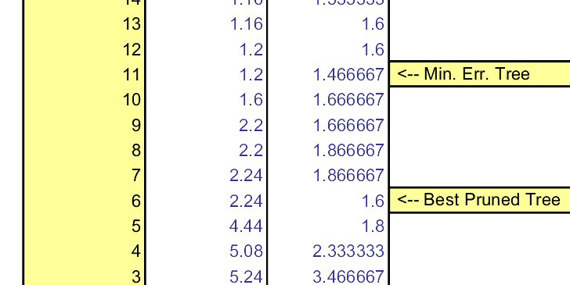
Error rates on pruned trees

Slide 21
ALGORITHM FOR PRUNING
Recursive binary splitting to grow a large tree on the training data,
Stopping only when each terminal node has fewer than some minimum number of observations
Apply cost complexity pruning to the large tree in order to obtain a sequence of best subtrees, as a function of α
Use K-fold cross-validation to choose α
Repeat #1 -#3 on the k-th fold
Estimate the MSE as a function of α
Average all and pick best α
Return the subtree from Step 3 that corresponds to the chosen value of α

Slide 22
Example:
Hitters data set:
Response variable: baseball player’s Salary
Predictors:
Years (the number of years that he has played in the major leagues)
Hits (the number of hits that he made in the previous year)
Walks, RBI, hits, putouts
Note: log-transform Salary so that its distribution has more of a typical bell-shape.

Slide 23
Notes:
How come test has error bars

Slide 24
Notes:
How come test has error bars

